Slide 2

Application Development with HTML5
Brandon Satrom
Developer Evangelist
Microsoft
DEV343
Notes:
Welcome everyone. I hope you’re enjoying your TechEd experience, and thank you for coming to this session.
HTML5 is here, and the web will never be the same. [Pause]
You probably know that, and you may even agree with me, but I’d be willing to bet that many of you are struggling to understand where HTML5 fits in your own development and in your companies. You should know you’re not alone. You should also know that there are ways to “evaluate and approach HTML5” that won’t suck up all of your free time.
My goal for today is to leave you not just with an understanding of what HTML5 means, but how you can go and start doing HTML5 development today in your existing sites, and how to keep up with everything new happening around HTML5. So let’s get started.

Slide 3


About Me
www.userinexperience.com
@BrandonSatrom
brsatrom@microsoft.com
Husband and father
Developer evangelist, Microsoft
Web developer for life
Based in Austin, TX
Notes:
First, a little about myself.
Image is owned by me.

Slide 4
What You Said You Wanted to Hear…
New features that can be used today
Semantic replacements for generic elements
Features we shouldn’t use because of compatibility problems
Best practices for HTML5 development
Coding HTML5, while retaining support for older browsers
New aspects of CSS3
Tools that help in leveraging HTML5 features
What should designers and developers learn first
Thanks
to Arunraj Chandrasekaran, Sahar Hosseini, Eric Graham, Emil Åström, Alexander Dunn, Nia Samir, Bob Elward and Ken Ingram for providing feedback!
Notes:
In preparation for this presentation, I decided to use a great feature on the Tech Ed website where I could ask for people to tell me what they wanted to get out of this presentation. I got a lot of great suggestions, and this list is a summary of that feedback.
Thanks to Arunraj, Sahar, Eric, Emil, Alexander, Nia, Bob and Ken for their suggestions. And if any of you are here in person, please come up and say hello. I’d love to meet you and thank you in person for taking the time to help me shape this talk.
This is the list of flagged things that people asked for on the MSTechEd Site in the discussion thread for this section. (http://northamerica.msteched.com/discussion/thread/?threadid=95bbea2c-a02f-e011-be0d-001ec953730b&fbid=ikY0Ef9jMhW)

Slide 5


What is “HTML5”?
The direction the web is going?
What’s new and interesting on the web?
Just some new markup?
All or none of these?
Notes:
Now, let’s start by asking the question, “what is HTML5?” To some, HTML5 is where the web is headed. To others, it means everything new and interesting on the web. To even others, it means just a handful of changes to the markup we write every day. I’ll talk to today about what I think HTML5 means…
Image from http://www.flickr.com/photos/studholme/4800906130/ (used with permission from boblet – License: Creative Commons Attribution)

Slide 6

“Upgrade the site to HTML5? by close of business TOMORROW?”
Notes:
Even more, important, though, is what HTML5 means to you, the tireless and enterprising web developer who’s starting to become more than a little overwhelmed with the pace and change and the volume of things you have to keep up with. I’m not just describing myself, am I? Surely not. It’s easy to become tired at the pace of change, so the last thing I want to do is overwhelm you, and I’m not here to drone on about all of the different new and cool things in the spec. Instead, I am here to equip you with tools you can use the minute you leave this room.
Image from http://www.flickr.com/photos/mindaugasdanys/3766009204/ (Used with permission from mdanys – License: Creative Commons Attribution)

Slide 7
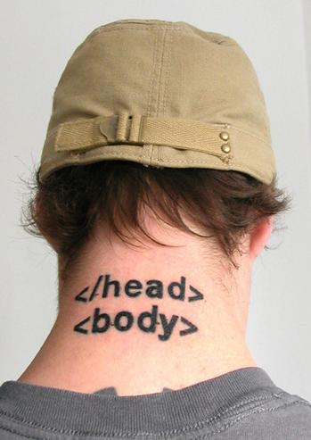
What does “HTML5” Mean to YOU?*
How you evaluate HTML5 technologies
What you choose to adopt
How you implement them
AND how to avoid leaving older browsers behind
*Tattoos optional
Notes:
Even though I can give you some ideas about what HTML5 means, I can’t honestly tell you what it should mean to you. So when I say, “What HTML5 means to you,” I mean that I want you to leave this room today with a definition of HTML5 that you can rely on, a process by which you can evaluate and choose HTML5 technologies, and how you can use these technologies today while ensuring that users visiting with older browsers still receive a great experience.
And if there’s anybody in this room not really interested in HTML5 because web development doesn’t really excite you, I’ll remind you that HTML5 is the future for our mobile devices as well, and there’s almost no better way to target mobile in a cross-platform way than HTML5.
Image from http://www.flickr.com/photos/daniello/422213306/ (used with permission from webmove – License: Creative Commons Attribution)

Slide 8
Agenda
Defining HTML5
The five most important words about HTML5
HTML5: mix tape edition
Some thoughts on development tools
Stuff you should learn
Notes:
So with all of that said, here’s our agenda for the day. We’ll start by defining the HTML5 standard. Then, I’ll give you the five most important words you need to know about HTML5. After that, I’ll walk through a demonstrate many of the HTML5 technologies and show you how to adopt those technologies and support older browsers. I’ll also talk about Microsoft’s process for adopting HTML5 technologies in the browser and where you can go to see what’s upcoming, experiment with newer Specifications and give us feedback. Finally, I talk briefly about updates to Microsoft’s developer tools around HTML5 and provide some resources to learn more about HTML5, JavaScript and CSS3

Slide 9
Defining HTML5*
*Air Quotes Required
Notes:
As I’ve said already today, HTML5 is a confusing term for a lot of people because its meaning is a moving target. Some narrowly define it to mean just the new markup and form elements. Others define it as whatever new technology they want to implement in their site. Other still use the term to mean everything new and interesting on the web, including old technologies not part of the official spec (Geolocation and SVG) and barely-implemented ideas that haven’t even reached draft status with the W3C (Notification API). So let’s arm ourselves with a more reasoned definition of HTML5 that we can use today, and in conversations with fellow developers, our co-workers and customers.

Slide 10
“ ”
+
+
=
JavaScript APIs
HTML
CSS 3
Geolocation
Web Storage
Web Sockets
FileAPI
Media Capture
IndexedDB
Etc…
Markup
Forms
ARIA
Microdata
Canvas
Video
Etc…
Selectors
Media Queries
Fonts
Transforms
Transitions
Animations
Etc…
Notes:
Here’s a definition of HTML5 that I like and which I think gels with how the W3C is thinking of HTML5: HTML plus CSS3 plus new JavaScript APIs = HTML5.
The best way to understand the term HTML5 is to look at it as an umbrella term that encompasses the HTML5 spec itself, many CSS3 Modules and a series of JavaScript APIs that enable rich and dynamic behavior in the browser. All told, there are over 100+ specs that encompass what many refer to as “HTML5,” I can’t even list everything on a single slide, much less talk about all of them today.

Slide 11








Technology Areas of HTML5
Performance
Semantics
Styling
Multimedia
3D Effects
Offline & Storage
Connectivity
Device Access
Notes:
I can give you some general categories that make up HTML5. Within this umbrella term exists a series of technology groupings defined by the W3C, each of which describes a several related specs. Keep in mind that this is the vision of HTML5, not a description of what is available for you today.
Performance – Faster and more dynamic web apps with Web Workers and XMLHttpRequest 2.
Semantics –A richer set of tags, along with RDFa, microdata, and microformats, are enabling a more useful, data driven web for both programs and your users.
Styling – CSS3 for richer styling and effects. Web Open Font Format (WOFF) provides typographic flexibility and control far beyond anything the web has offered before.
Multimedia – Audio and video are first class citizens in the HTML5 web.
3D Effects - SVG, Canvas, WebGL, and CSS3 effects
Offline & Storage – Web Apps start faster and work even if there is no internet connection, thanks to the HTML5 App Cache, as well as the Local Storage, Indexed DB, and the File API specifications.
Connectivity –Web Sockets for real-time connections and Server-Sent Events for server-to-client communication.
Device Access – Geolocation, Device Access (a/v, mics and cameras and more)
Images from www.w3.org/html/logo (Used with permission)

Slide 12
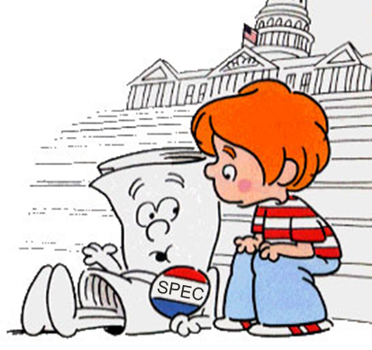
“I’m Just a Spec, Yes Only a Spec”
First Published Working Draft
Last Call
Candidate Recommendation
Working Draft
Recommendation
Canvas
Fonts
Forms
Markup
Messaging
Microdata
Transforms
Transitions
Web Sockets
Web Storage
Server-Sent Events
SVG 1.1 (2nd Ed)
Web Workers
WOFF
Geolocation
Media Queries
WAI-ARIA
MathML
SVG 1.1
Selectors (L3)
Notes:
Because HTML5 consists of over 100 specifications, you should be aware that the “readiness of HTML5” is not something that can be pinned down or answered with a single data or as a yes or no question. Every specification under the HTML5 umbrella follows the same five-stage process from inception to recommendation, but each specification moves independently through that process. Some items under the umbrella are in candidate or recommendation state. Others are in last call and nearing completion. Many, as you’ll notice are at the Working Draft stage, even as several of these, like Canvas, CSS Transforms and Web Storage are being widely adopted by the major browsers.
They takeaway for you is this: HTML5 is a term that represents a lot of what’s new and what’s next on the web, but it itself is not “one thing.” It’s not even a bunch of things that are all “site ready” today, or things that most browsers even support. There is no such thing as “adopting HTML5” or “upgrading your site to HTML5.” Instead, as a web developer, there are technologies within the HTML5 set of specifications that you will or will not choose to adopt. Some are ready for you today, and you should use them. Others still need time, but you should be aware of them and follow them through the specification process.
Image from http://www.sableverity.com/wp-content/uploads/2009/12/Im-just-a-bill.jpg (Used with permission – License: Creative Commons Attribution)

Slide 13
The Five Most Important Words about HTML5*
* “Validation” isn’t one of them.
Notes:
So at this point, you might be feeling a bit overwhelmed. HTML5 is HUGE! How can you possibly learn it all?
For the rest of this presentation, I want to equip you with a few things: First, a set of five words that, I believe, represent the breadth of what matters about HTML5. Once we have these, I’m going to shift to talking about those technologies under the HTML5 umbrella that are “site ready” for you to use today. Then, I’ll talk about how you can stay abreast on which specifications are coming in the next version of our browser, as well as what the future might hold.

Slide 14
#1 – Hyperbole*
*It’s the best thing ever!
Notes:
The first word is Hyperbole. You knew that HTML5 was a big deal, right? But did you know how big of a deal? It seems like HTML5 is everywhere these days.

Slide 15
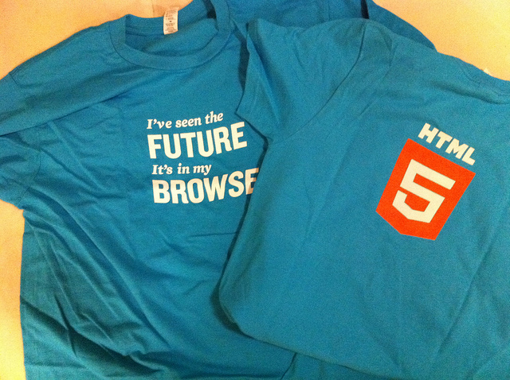
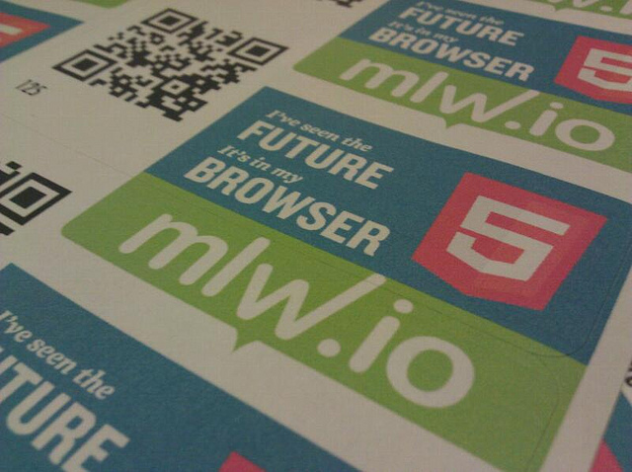
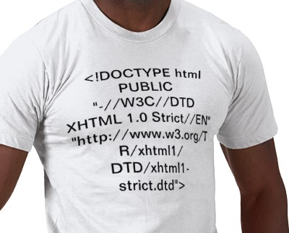
Next Up, an Album of Tony Bennett Covers…
Notes:
HTML5 is big. So big, that is has its own logo, stickers and T-Shirts.
I never had an XHTML1.1 t-shirt. Did you? [Click]
Images from:
T-shirt from: http://www.flickr.com/photos/igb/5409072809/ (User igb)
Stickers from: http://www.flickr.com/photos/cvander/5569384441/ (User cvander)
Fake XHTML t-shirt design: http://bit.ly/gfrKyl - Image is Mine
(All used with Permission – License: Creative Commons Attribution)

Slide 16


“Don’t Believe the Hype…”
“Taffeta phrases, silken phrases precise, three-piled hyperbole, spruce affectation, figures pedantical — these summer flies _{have} blown me full of maggot ostentation. _{I do forswear them.”}
– William Shakespeare
Notes:
The truth is, as many things in life, HTML5 is surrounded by a lot of hyperbole and exaggeration. It’s not going to “fix” the web, and it’s not going to solve all of your problems as a developer. You’d be wise to treat all platitudes and posturing around HTML5 with a grain of salt. In the immortal words of the playwright Shakespeare as paraphrased by the great 20th Century poet Flavor Flav, “Don’t believe the hype…”
Image from http://www.flickr.com/photos/tonynetone/2688212829/ (Used with permission – tonynetone – License: Creative Commons Attribution)

Slide 17
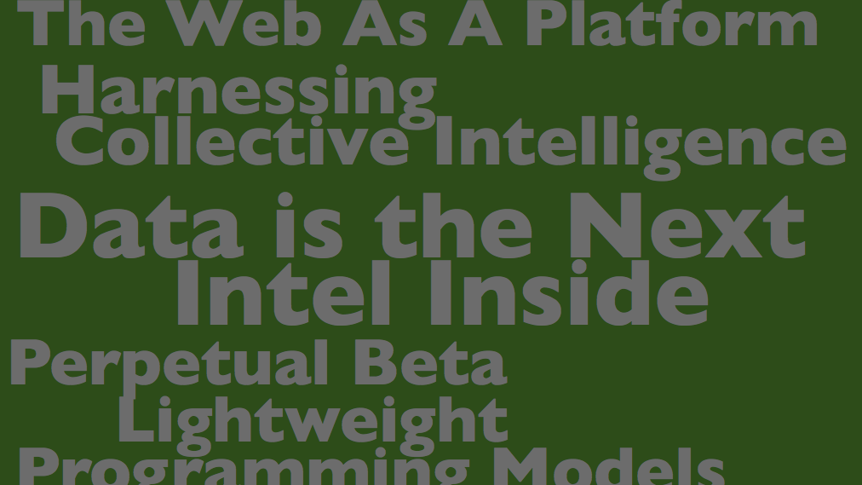
Do believe that HTML5 is changing everything.
“The future of the web is HTML5.” – Dean Hachamovitch, Microsoft
“We’re betting big on HTML5.” – Vic Gundotra, Google
“The world is moving to HTML5.”
– Steve Jobs, Apple
Notes:
…but do believe that HTML5 is important. Hyperbole or not, HTML5 is big. In many ways, it is the final realization of much of the hype around Web 2.0 that emerged in the middle of the last decade. And it is the biggest thing to happen to the web in 20 years, so it is worth your time and attention. You have a bit of a balancing act here as a developer in trying to avoid the hype while also embracing the scope of what’s changing now and over the next 3-5 years.
Image from http://www.flickr.com/photos/psd/3641609001/ (used with permission from psd – License: Creative Commons Attribution)

Slide 18
#2 - Compatibility*
*Your GeoCities sites are safe.
Notes:
The next word is compatibility.

Slide 19

The Web is the Largest Legacy Software System in the History of the Universe
Notes:
And this may sound a bit hyperbolic, but it’s not. The web has over 50 years of history. That’s fifty years of servers and software that power the sites we depend on every day. Some popular sites are nearly a decade old. Others are older. Nearly everything that’s ever been created for the web still resides somewhere, waiting for someone to visit with a browser. Regardless of the bells and whistles of new specs and new browsers, those old pages should not be left behind. As such, HTML5 was build with compatibility in mind. We’re moving the web forward, but not at the cost of breaking everything that’s come before.
Compatibility also means that browsers need to play nice, and that we need to move past the browser wars of the past and STOP differentiating on features or APIs in HTML and JavaScript, and instead standardize what happens “within the lens” that is your browser and let browser vendors differentiate on browser features like security and performance and user experience. With HTML5, the W3C has finally arrived at a mature process whereby which ALL of the major browser vendors have agreed to play nice. You, I and all of our customers benefit as a result.
Image from http://www.flickr.com/photos/paalia/2806711443/ (Used with permission from user paalia – License: Creative Commons Attribution)

Slide 20
#3 - Semantics*
*Tags have meaning.
Notes:
Semantics is an important word on the web as it relates to markup. Semantic means “meaning”. Simply put, semantic markup is html that clearly conveys to the browser and developer it’s meaning, or purpose for being on the page.

Slide 21
Neutral vs. Rich Semantics
<div>
<div id=“header”>
<header>
Notes:
In the context of semantics, you’ll often hear the terms semantically neutral or semantically rich thrown around. The <div> [Click] is a semantically neutral element, and is a perfect example of why we need deeper meaning in HTML. By itself, it conveys no meaning to the document, to a User Agent (browser) or to a developer. Assigning Ids to these divs [Click], as is the current practice, is better, and conveys more meaning to developers, but it useless to browsers as they are not allowed to infer any meaning from the IDs of elements. HTML5 introduces elements like <header> [Click], which conveys clear meaning of the intent of the element (eg. it is semantically rich). A great deal of time was spent in delivering a richer set of semantic markup in HTML5, and header is just one example.

Slide 22
#4 – JavaScript*
*It’s not your father’s scripting language. Well, ok... actually it is.
Notes:
Next up, JavaScript, which I’m counting as one word because there’s no space. If you’re anything like me, and you did web development in the late 90s and early 00s, you probably considered JavaScript a bit of a toy language. If you’re also like me, you probably also re-discovered JavaScript through a framework like jQuery. And if that’s the case, as Scott Hanselman would say, you’re not really writing JavaScript, you’re writing jQuery.
If you’re serious about HTML5, though, you won’t get far without digging back into JavaScript. The HTML5 spec is rife with tons of new JavaScript APIs that you need to learn to leverage these technologies (Geolocation, Canvas, Storage, etc.) If JavaScript wasn’t back to being a first-class language for you yet, it should be now.

Slide 23
JavaScript and the Growth of the Client
JavaScript
1990’s
Client
Server
Database
JavaScript
2000’s
Client
Server
Database
JavaScript
Today
Client
Server
Database
Notes:
In fact, just looking at how the relationship between the client, server and database has evolved, and how the expansion of JavaScript correlates with those changes should be enough to convince you that JavaScript is a serious language. In the late 90s, JavaScript was more of a nuisance that anything else for most developers. Not only that, but it wasn’t even supported or enabled in all browsers. Ajax changed all of that, and by the time 2005 rolled around and the term Ajax was officially coined, JavaScript had contributed to providing another level of richness on the Web. The client “grew” as more work was deferred to JavaScript on the client. This growth has only continued over the last six years, and HTML5 is proof that JavaScript is a key cornerstone of the web.

Slide 24
#5 – Polyfills*
*It’s like shims in JavaScript…for hipsters.
Notes:
According to Paul Irish, a polyfill is “…a shim that mimics a future API, providing fallback functionality to older browsers.” Polyfills are like spackle for your web sites. You can use them to fill in the gaps in older browsers that don’t support the HTML5 functionality you want to add to your site.
If you’re skeptical about using HTML5 today because of a lack of support in older browsers, you don’t have to be. We, as web developers, are resourceful and professional enough to create best-practices that allow us to build apps with these features now. Learning how to use polyfills is KEY to helping you use these new technologies today without leaving users of older browsers behind.

Slide 25
Ex. Polyfills with Modernizr
article { -moz-border-radius:10px; -webkit-border-radius:10px; border-radius:10px; }
$(function() {
if (!Modernizr.borderradius) {
// Use a jQuery plugin to round those corners
$.getScript("js/jquery.corner.js", function () {
$("article").corner();
});
}
});
“Polyfill” support with a jQuery plugin
Not supported in older browsers!
Notes:
Probably the most popular library associated with polyfills is Modernizr (www.modernizr.com), a JavaScript library that adds classes to the DOM which allows you to target specific browser functionality and provide fallback solutions for older browsers. One example where this could be useful is Geolocation. If you wanted to use Geolocation in your site, you can use Modernizr to detect if Geolocation is supported in the user’s browser (you could also do this yourself, btw) and if it is, you can offer to find them automatically. If not, you can fall back to a form that allows them to manually enter their address.
Modernizr can also be used to “plug the gaps” and offer functionality to all users. In the example above, I’m using CSS3 to round the corners of each <article> element on my page. Older browsers don’t support this feature, but I can still provide it if I want to by checking Modernizr for the border radius property and using a jQuery plugin that provides that feature for me.
It would probably be useful to mention here that Polyfilling isn’t always required when adopting an HTML5 technology. In some cases, adoption will give users with modern browsers an enhanced experience, but won’t break an older browser’s experience. Many of the new CSS modules are great examples of, including border-radius. So it is possible to adopt a new feature and pay no attention to older browsers. They key is that you need to be aware of how a new feature will affect older browsers.

Slide 26
HTML5: Mix Tape Edition*
* Things you should use, things you should polyfill and
things you should experiment with and prototype.
Notes:
For this next section of the presentation, we’re going to drill down into a big chunk of HTML5 technologies, and I’m going to show you demos of some of what’s new and is coming in HTML5.
With each technology I talk about, I want to be sure to answer the question: “Can I use this today?” So I’m going to spend the bulk of my time today on those things that you can and should start using in your applications now. I’ll demonstrate both how to target these new features, and how to support users with browsers where these features don’t exist.
After covering a handful of notable areas of the spec, I’ll speed through a couple of other areas that you should also be paying attention to. Some of these are new and unproven, while others are ready for primetime, but they’re all generating a lot of buzz on the web.
And while I don’t have near enough time to talk about everything, hopefully this will be a good cross-section of what’s in “the spec.”

Slide 27
Adopt (and Polyfill)*
*Mature, Site-Ready HTML5
Notes:
First off, let’s talk about those things you can and should adopt today for your applications. These are the things we are referring to as “Site-Ready HTML5,” which means they have the broadest support across all modern browsers and you can rely on them being available to a large segment of your users. In addition, I’ll also discuss how you can polyfill support for older browsers.

Slide 28
Semantic Markup*
*Alas, poor <div>, I hardly knew ye.
Notes:
You’ll recall that semantics was one of our five words, because it’s important to understand why HTML5 introduces changes to the HTML5 markup specification, both by eliminating unneeded cruft and adding more semantically-rich elements.

Slide 29
A Sample XHTML Document
<!DOCTYPE html PUBLIC "-//W3C//DTD XHTML 1.0 Strict//EN" "http://www.w3.org/TR/xhtml1/DTD/xhtml1-strict.dtd">
<html>
<head>
<meta http-equiv="content-type" content="text/html;
charset=utf-8">
</head>
<body>
<p> XHTML :/ </p>
</body>
</html>
Notes:
Let’s talk about unneeded cruft, first. You’ve seen this, no doubt. This is the smallest XHTML document that I could create, and it still barely fits in this slide. HTML5 changes this drastically, and you can use those changes today in any browser, even older ones. You pages will still render.

Slide 30
A Sample HTML5 Document
<!DOCTYPE html>
<html>
<head>
<meta charset="utf-8">
<title> Hello </title>
</head>
<body>
<p> HTML5! </p>
</body>
</html>
Notes:
This is all you need to create a valid HTML5 document. The Doctype and meta http-equiv tags been changed. It’s nice to get that cruft out of the way.

Slide 31
28 New Elements
article | footer | rt
aside | header | ruby
audio | hgroup | section
canvas | keygen | source
command | mark | summary
datalist | meter | time
embed | output | wbr
figcaption | progress
figure | rp
article | footer | rt
aside | header | ruby
audio | hgroup | section
canvas | keygen | source
command | mark | summary
datalist | meter | time
embed | output | wbr
figcaption | progress
figure | rp
Notes:
So we’re gotten some cruft out of our markup. We’ve also added new elements.
Here’s a list of all of the new markup elements defined in HTML5. I’m not going to cover most of these today, though I will briefly cover the highlighted items. There is tons of information about them available online and in great books like “HTML5 Up and Running” and “Introducing HTML5.” Remember that word “semantic?” The beautiful thing about this list is that most of these probably mean exactly what you think they mean.

Slide 32
Semantic Markup
demo
Notes:
Let’s take a look at some of these new elements now.

Slide 33
Canvas and SVG*
*Your old Nintendo games, reborn! (Plus DOOM)
Notes:
Now let’s look at Canvas and SVG, two graphics technologies for the web.

Slide 34
<canvas> + JavaScript = Crazy Delicious
var canvasContext = document.getElementById("canvas")
.getContext("2d");
canvasContext.fillRect(250, 25, 150, 100);
canvasContext.beginPath();
canvasContext.arc(450, 110, 100,
Math.PI * 1/2, Math.PI * 3/2);
canvasContext.lineWidth = 15;
canvasContext.lineCap = 'round';
canvasContext.strokeStyle =
'rgba(255, 127, 0, 0.5)';
canvasContext.stroke();
Notes:
You can think of the canvas element, just like it sounds: a blank drawing surface embedded in your page. Adding <canvas> is as simple as adding the canvas tag, but you manipulate the canvas from JavaScript, where you can add shapes, text, images, gradients, transformations, effects and even animation. The canvas element is a pixel-based drawing surface.
Remember how I said JavaScript was important? Without it, all you can do with Canvas is put an element on the page. You need JavaScript to manipulate it. In this slide, we’re selecting the 2d context of the canvas, adding a rectangle, then adding a orange arc with rounded corners to the canvas.
In many ways, the Canvas is a scriptable Image tag, which is a powerful concept.
[Image captured from my computer]

Slide 35

<svg> + <html> = Stylable, Scriptable SVG
<svg xmlns="http://www.w3.org/2000/svg" viewBox="0 0 220.5 199.5">
<title>HTML5 CSS Styling Logo</title>
<path d="M32.8,0L25.4,37.0 176.0,37.0 171.3,60.9 20.6,60.9 13.3,97.9 163.9,97.9 155.5,140.1 94.8,160.2 42.2,140.1 45.8,121.8 8.8,121.8 0,166.2 87.0,199.5 187.3,166.2 200.6,99.4 203.3,86.0 220.4,0z"/>
</svg>
<style>
svg path {
fill: navy;
}
</style>
Notes:
SVG is an older graphics specification, but a powerful one. SVG, or Scalable Vector Graphics, is actually a family of specifications around providing an XML-based file-format for two-dimensional vector graphics.
SVG can be represented as a standalone .svg file or embedded as xml into your markup. Inline SVG gives you a powerful way to work with vector graphics on you page, and because it’s markup and not a binary image, you can manipulate and style anything in the SVG element and you can use script to interact with the element, much like you do with canvas.
[Image captured from my computer]

Slide 36
<canvas> and <svg>
demo
Notes:
Let’s take a look at canvas and svg in action.

Slide 37
Audio and Video*
*Media without Plugins, but lots of Codecs
Notes:
Next, we’ll look at two related elements that standardize how rich media is presented to users through the browser.

Slide 38

Media on Your Page… No Plugins Required.
<video id=“video" controls autoplay>
<source src="video.mp4" type="video/mp4“ />
</video>
document.getElementById("video").play();
<audio id="audio" src="sound.mp3" controls></audio> document.getElementById("audio").muted = false;
Notes:
Audio and Video are some of the most talked about new elements and, on face, they are very easy to use. Practically though, Codecs complicate both audio and video because even though all browsers implement these new tags, not all agree on the proper Codecs to support. So using audio and video today is possible, but you should, as a best practice, provide at least 3 sources of video(WebM, MP4 and Ogg Vorbis) and 2 of Audio (mp3, Ogg Theora) and fallback to Silverlight or flash for browsers that don’t support Video and Audio tags.
[Image captured from my computer]

Slide 39
<video>
demo
Notes:
Let’s take a look at using audio and video, and at how to provide fallback.

Slide 40
Geolocation*
*Now you can try Geocaching with your ten pound laptop.
Notes:
Though not “technically” part of the HTML5 specification, it’s hard not to bring Geolocation to the party because it’s another example of the richness and interactivity coming to web applications.

Slide 41
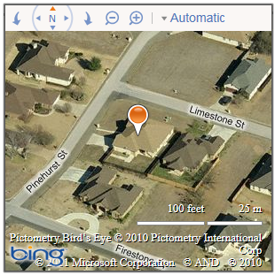
You are (within a Few Hundred Meters of) Here
//Get my location, and put it on a map
navigator.geolocation.getCurrentPosition(function(position) {
var location = new Microsoft.Maps.Location(
position.coords.latitude,
position.coords.longitude);
_map.setView({ zoom: 18, center: location });
var pin = new Microsoft.Maps.Pushpin(location);
_map.entities.push(pin);
}, errorHandler);
Notes:
If you have a smartphone, you’ve no doubt used Geolocation provided to apps by your device. With Geolocation support in all major browsers, desktop and mobile web applications can support Geolocation as well. Here, we’re retrieving the user’s current location and using the result to populate a map.
[Images captured from my computer]

Slide 42
Geolocation
demo
Notes:
Now let’s quickly add Geolocation (with fallback and graceful degradation) to our site.

Slide 43
Storage*
*Watch those cookies crumble…
Notes:
Next up, storage. Who still fights with cookies on their sites? HTML5 introduces a new key/value storage mechanism often referred to cookies on steroids. They’re not cookies, though, because you have more space for local storage (up to 5mb), and the storage items are not transferred back to the server on each request, as cookies are, so using them wont slow down your site.

Slide 44
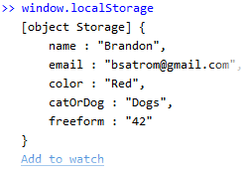
Working with localStorage
$('#save').click(function () {
window.localStorage.setItem('name',$('#name').val());
window.localStorage.email = $('#email').val();
});
$('#name').val(window.localStorage.getItem('name'));
$('#email').val(window.localStorage.email);
Notes:
Local storage is targeted at providing you the developer with a way to capture and store user-specific data in the users browser, without transmitting that information back to the server. These things are scoped only to a domain, and live beyond the browser session, meaning you can pull and use them long after the user leaves the site. Note, as in the example here, that you can access localStorage both via getItem and setItem functions, or access the value directly using the key.
Local storage is supported in all major browsers, and has support in IE in versions 8 AND 9. What’s more, if you want to adopt Storage more broadly, there are polyfilling options that enable you to use localStorage all the way back to IE5.
[Image captured from my computer]

Slide 45
Local Storage
demo
Notes:
Let’s take a look at leveraging localStorage by adding the capability of saving user preferences locally in the browser, and then loading those. [Be ready to speak to security of these items (sandboxed to site, etc.)]

Slide 46


Experiment*, Prototype, Give Feedback…
* Use IE10 PP and Html5 Labs to try out upcoming features.
Notes:
Now, let’s talk about how Microsoft approaches HTML5 Spec adoption, as well as how you can try out what’s on the bleeding edge of HTML5.

Slide 47

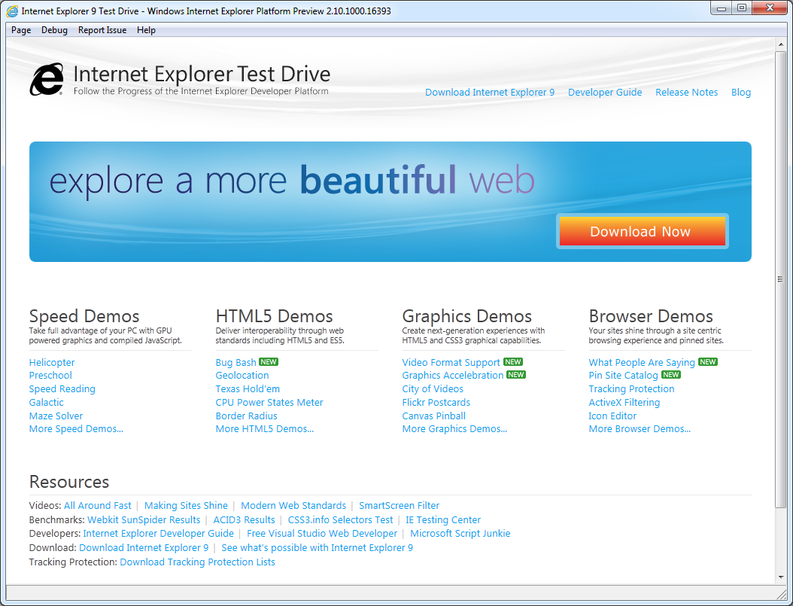
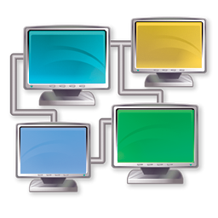
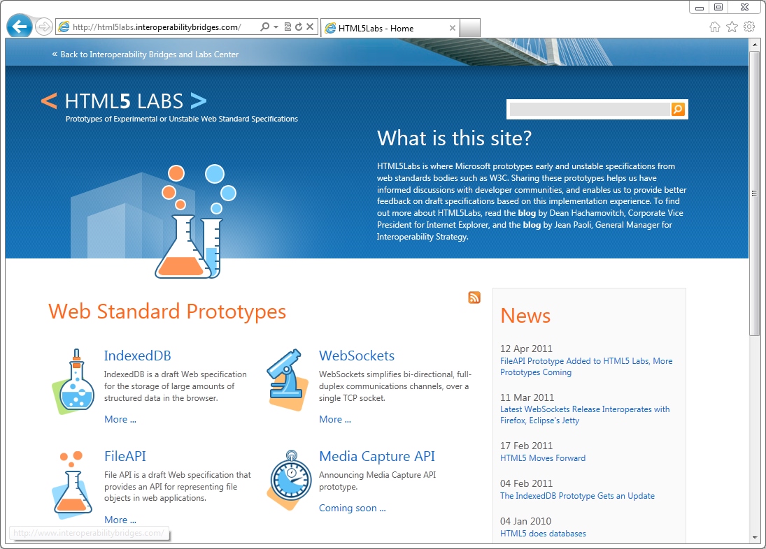
Microsoft Approach
Site Ready
HTML5
Work with
Developers
Invest on Interoperability
Innovate with Emerging Standards
Notes:
Microsoft’s Approach is fourfold:
We want to give you the best Site Ready HTML5 experience on the web via IE9. We’ve already talked a lot of IE9 today and what IE9 supports.
Beyond that, we are proactive about letting you the developer know what’s coming in the next version of our browser with the IE Platform previews.
We’re invested heavily in interoperability and have created, by far, the largest HTML5 test suite for the W3C.
And finally, we’ve created the HTML5 Labs to show how were thinking about emerging and unstable standards and how you the developer can experiment with these.
I’ll talk briefly now about the second and fourth items on this list.
[Slides provided by Internet Explorer team. Images used with permission]

Slide 48
Work with Developers
IE 10
PP1 & PP2
RTM
PP8
New in IE10:
CSS3 Flexbox
CSS3 Gradient
ECMAScript Strict
Web Workers
Forms & Validation
Drag and Drop
File API
PP7
PP6
Beta
PP4
PP3
PP2
Platform Preview 1
3.16.10
5.5.10
6.23.10
8.4.10
9.15.10
10.28.10
11.17.10
2.10.11
3.14.11
4.12.11
6.29.11
Notes:
If what we talked about with HTML5 today just wet your appetite for HTML5, you’ll want to take a look at the IE Platform Previews to see where Microsoft is going with HTML5 in the future. On April 12, just weeks after the launch of IE9, we dropped the first Platform Preview of IE10, which included several new CSS3 and ECMAScript features.

Slide 49
IE10 Platform Preview
demo
Notes:
Let’s take a quick look at the IE10 Platform Preview, specifically some of the new CSS Features that we’ve released.

Slide 50
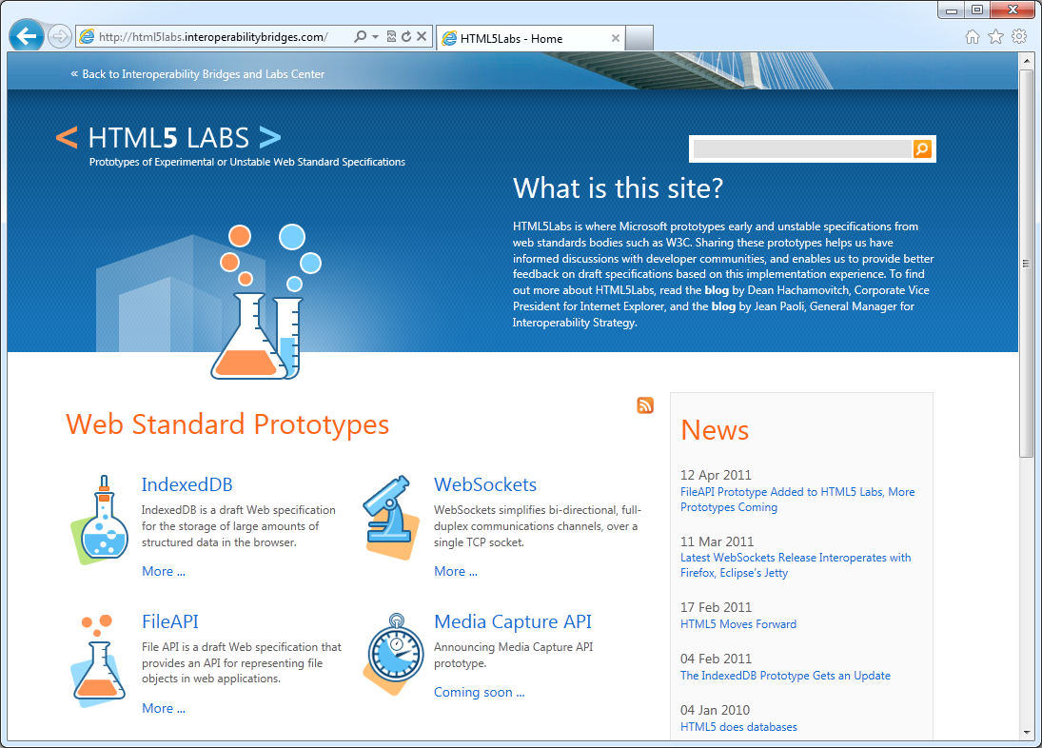
Innovate with Emerging Standards
Notes:
Beyond what we have today in IE9, and what’s coming in IE10, We want to give developers a platform to try out some experimental standards that are still being vetted by the W3C. Html5labs.com is a place you can go to see what we’re thinking about. Let’s look at a couple of those now.
[Image from my computer]

Slide 51
Web Sockets – Real Time Connections
var socket = new WebSocketDraft('ws://my.websocket.org/echo'); socket.onopen = function(event) { socket.send('Hello, WebSocket'); }; socket.onmessage = function(event) { alert(event.data); } socket.onclose = function(event) { alert('closed'); }
Client
HTTP
Server
TCP
Notes:
Web Sockets are a Full-duplex, bi-directional communication over the Web: Both the server and client can send data at any time, or even at the same time. Only the data itself is sent, without the overhead of HTTP headers, dramatically reducing bandwidth.
Web Sockets has been the subject of a lot of press and debate due to its early inclusion and subsequent removal from some browsers, but the technology isn’t gone. In fact, it’s being actively worked on by two standards bodies as we speak. Microsoft has published several updates to our demo Web Sockets implementation, and continues to update the demo with each publication of the specification. Try it out for yourself at HTML5Labs.com
Web sockets are accessed through the WebSocket object. Sites open a socket at an end point, send messages and respond to new messages.

Slide 52
FileAPI – File Objects in Web Apps
var file = document.getElementById('file').files[0];
document.getElementById('name').textContent = file.fileName; document.getElementById('size').textContent = file.fileSize; var reader = new FileReaderDraft(); reader.readAsText(file);
EvilPlans.txt
Name
Size
Data
Notes:
The FileAPI is a W3C draft Web specification for representing file objects in web applications, as well as programmatically selecting them and accessing their data. The FileAPI is currently being standardized by the W3C Web Applications Working Group. HTML5 Labs has a downloadable prototype for working with the FileAPI that you can download at html5labs.com

Slide 53
HTML5 Labs, Web Sockets and FileAPI
demo
Notes:
Let’s take a quick look at HTML5 Labs, and specifically some demos around Web Sockets and the File API

Slide 54
HTML5 in Web Technologies
VS 2010 SP1 – HTML5 Schema and Intellisense
WebMatrix – HTML5 default doctype
ASP.NET MVC 3 tools update
HTML5 template for new projects
Modernizr 1.7 included in new projects
Expression Web 4 SP1 – HTML5 Schema and Intellisense
Richer CSS style editing
SuperPreview Page Interaction Mode and Online Service
Notes:
I’ve shown you three different tools in our demos today: VS 2010, Web Matrix and Expression Web 4. Each of these tools already has support for HTML5 markup and CSS3, out of the box, as you’ve seen. And I’m sure this is just the beginning of what Microsoft will offer developers related to HTML5.
One thing that I do want to mention that I didn’t show, but is related to your HTML5 development is the new SuperPreview in Expression Web 4 SP1. If you’re not familiar with SuperPreview, it’s a tool in Expression Web (and also available as a Standalone download) that enables you to view your site across multiple browsers in several modes, side-by-side, overlaid to see minor differences and in a DOM mode which shows the DOM created across multiple browsers. SuperPreview in Expression Web 4 SP1 adds even more features like the ability to test pages behind a login and to use an online service to test you site in browsers NOT currently running on your machine, so you no longer need to have several browsers installed on your machine solely for the purpose of testing.
[If question comes up] MS is committed to providing tool support for standards based web development, beyond this and into the future.

Slide 55
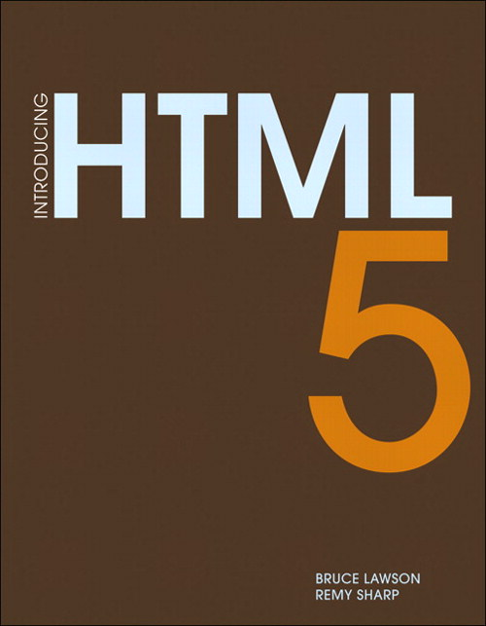


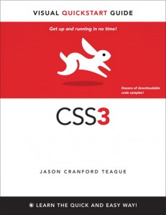


Things You Need to Learn (a.k.a. Resources)
Read two good HTML5 books
Read a good CSS3 book
Relearn JavaScript
Learn a JavaScript framework
jQuery, for instance
Learn the dev tools in your favorite browser
IE9? Just hit F12!
Notes:
Your call to action is simple: read, learn and use. Read some books on HTML5, JS and CSS, and some of the ones I love are available in the bookstore on site, so go pick them up and start reading today. Learn JS and jQuery and learn to really use the developer tools in your favorite browser. If that’s IE9, just hit F12.
Image of Introducing HTML5 from http://www.peachpit.com/store/product.aspx?isbn=0321687299
Image of HTML5 Up and Running from http://oreilly.com/catalog/9780596806033
Image of CSS3: Visual Quickstart Guide from http://www.speaking-in-styles.com/index.php/the-book/css3-visual-quickstart-guide/
Image of JavaScript: The Good Parts from http://oreilly.com/catalog/9780596517748/
Image of Eloquent JavaScript from http://oreilly.com/catalog/9781593272821/
Image of jQuery in Action from http://www.manning.com/bibeault2/
(All book cover images are public domain)

Slide 56
Go Start Using HTML5 Today!
– Semantic Markup
– Canvas
– Audio and Video
– Geolocation
– Web Storage
– CSS3
Adopt
@BrandonSatrom
www.userinexperience.com
brsatrom@microsoft.com
Experiment
– IE10 Platform Preview
– HTML5 Labs
Notes:
As we wrap up, I want you to remember that HTML5 is a large set of shifting technologies. Hopefully I’ve given you 1) a concise definition of HTML5, 2) the ammunition to choose what you’re ready to adopt today, 3) what you need to do to adopt new technologies while continuing to enable great experiences for older browsers and 4) where you can go to find out what’s on the bleeding edge.
The Web today is changing faster than ever before, and that pace isn’t slowing. As a web developer, you can keep up and even stay ahead of this change by staying aware of what you can use today, and what you should keep an eye on.
Thank you for coming today, now go and build the next great Web Applications.

Slide 57
Related Content
Required Slide
Speakers, please list the Breakout Sessions, Interactive Discussions, Labs, Demo Stations and Certification Exam that relate to your session. Also indicate when they can find you staffing in the TLC.
DEV334 | HTML5 and CSS3 Techniques that You Can Use Today
DEV353 | Pragmatic JavaScript, jQuery and AJAX with Microsoft ASP.NET
DEV205 | Microsoft Expression for Developers: Demystifying UI Design
DEV348 | Debugging Pesky HTML5 Websites with F12 in Internet Explorer 9
DEV348 | Using JavaScript to Build HTML5 Applications
DEV332 | Enhancing Pinned Sites with Windows Internet Explorer 9
Find me online at @BrandonSatrom
Email me at brsatrom@microsoft.com

Slide 58
Track Resources
Required Slide
Track PMs will supply the content for this slide, which will be inserted during the final scrub.
Resource 1
Resource 2
Resource 3
Resource 4

Slide 59





Resources
Connect. Share. Discuss.
http://northamerica.msteched.com
Learning
Sessions On-Demand & Community
Microsoft Certification & Training Resources
www.microsoft.com/teched
www.microsoft.com/learning
Resources for IT Professionals
Resources for Developers
http://microsoft.com/technet
http://microsoft.com/msdn

Slide 60












Required Slide
Complete an evaluation on CommNet and enter to win!

Slide 61
MS Tag Placeholder Slide
Required Slide
Your MS Tag will be inserted here during the final scrub.
Notes:
New for TechEd 2011, we will be working with Microsoft Tag (http://tag.microsoft.com/overview.aspx) to create unique Tags for every session at the event. Your session Tag will appear on both the room signage and at the end of your presentation. With your session Tag, attendees will be able to scan as they enter the room to retrieve session details, view speaker bios, and engage in discussions; or scan at the end of the presentation to evaluate your session and download materials. We’re excited to integrate Microsoft Tag across the My TechEd mobile experience this year.

Slide 62

© 2011 Microsoft Corporation. All rights reserved. Microsoft, Windows, Windows Vista and other product names are or may be registered trademarks and/or trademarks in the U.S. and/or other countries.
The information herein is for informational purposes only and represents the current view of Microsoft Corporation as of the date of this presentation. Because Microsoft must respond to changing market conditions, it should not be interpreted to be a commitment on the part of Microsoft, and Microsoft cannot guarantee the accuracy of any information provided after the date of this presentation. MICROSOFT MAKES NO WARRANTIES, EXPRESS, IMPLIED OR STATUTORY, AS TO THE INFORMATION IN THIS PRESENTATION.

